Slide 1
Time dependent quantum trajectories for open quantum systems
Christopher Kitching (10134621)
Elanor Harrington (10134324)

Slide 2

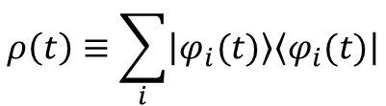



Mathematical formalism of open quantum systems
Density operator:
$$ρ\left(t\right)≡\sum_{i}{\left|\left.φ_{i}(t)\right\rangle \right.\left\langle \left.φ_{i}(t)\right|\right.}$$
Liouville von-Neumann equation:
$$\frac{∂}{∂t}ρ\left(t\right)=−i\left[H\left(t\right),ρ(t)\right]$$
System
H_{s}
Environment
H_{E}
H_{I}
Total Hamiltonian:
$$H= H_{0}+H_{I}$$
Interaction picture:
$$\hat{\tilde{O}}≡U_{0}^{†}(t,t_{0})\hat{O}U_{0}(t,t_{0})$$
Reduced density operator:
$$ρ_{s}\left(t\right)= {Tr}_{E}(ρ(t))$$
Figure 1: Image showing the general framework of an open quantum system. The open system, S, is the subsystem of a larger combined system, S+E, where E represents the environment.

Slide 3
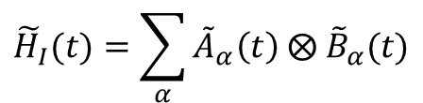
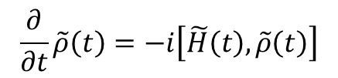
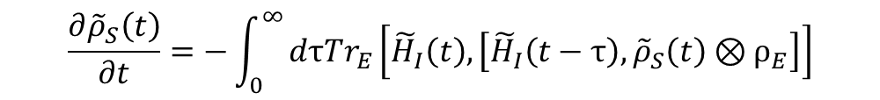
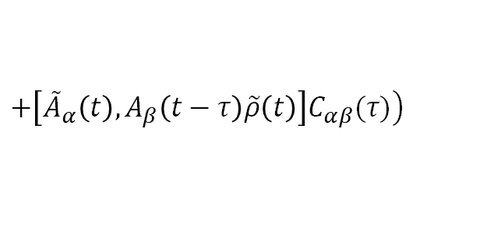
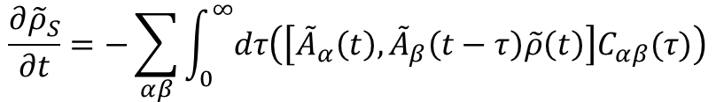
Master equations in Lindblad form
$$\frac{∂}{∂t}\tilde{ρ}\left(t\right)=−i\left[\tilde{H}\left(t\right),\tilde{ρ}\left(t\right)\right]$$
$$\frac{∂{\tilde{ρ}}_{S}\left(t\right)}{∂t}=−\int_{0}^{∞}{dτTr_{E}\left[{\tilde{H}}_{I}\left(t\right),\left[{\tilde{H}}_{I}\left(t−τ\right),{\tilde{ρ}}_{S}\left(t\right)⊗ρ_{E}\right]\right]}$$
$$\frac{∂{\tilde{ρ}}_{S}}{∂t}=−\sum_{αβ}{\int_{0}^{∞}{dτ\left(\left[{\tilde{A}}_{α}\left(t\right),{\tilde{A}}_{β}\left(t−τ\right)\tilde{ρ}\left(t\right)\right]C_{αβ}(τ)\right)}}$$
$$+\left.\left[{\tilde{A}}_{α}\left(t\right),A_{β}\left(t−τ\right)\tilde{ρ}\left(t\right)\right]C_{αβ}(τ)\right)$$
Interaction picture master equation
Correlation functions
$$C_{αβ}(t,s)={\left\langle B_{α}(t)B_{β}(s)\right\rangle }_{E}=Tr(B_{α}(t)B_{β}(s)ρ_{E})$$
$\left[H_{E}, ρ_{E}\right]=0 ⇒ C_{αβ}(t,s)$= $Tr(B_{α}(t−s)B_{β}ρ_{E})≡C_{αβ}(t−s)$

Slide 4
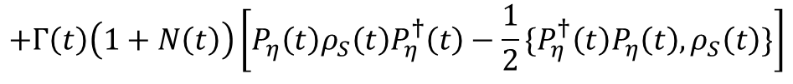

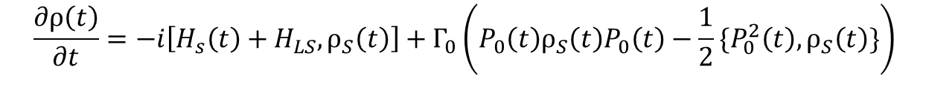




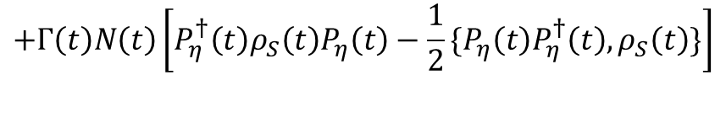
Spin-boson model
Spin-boson Hamiltonian:
Secular
master
equation
$$\frac{∂ρ\left(t\right)}{∂t}=−i\left[H_{s}\left(t\right)+H_{LS},ρ_{S}\left(t\right)\right]+Γ_{0}\left(P_{0}\left(t\right)ρ_{S}\left(t\right)P_{0}\left(t\right)−\frac{1}{2}\{P_{0}^{2}\left(t\right),ρ_{S}\left(t\right)\}\right)$$
$$+Γ\left(t\right)\left(1+N\left(t\right)\right)\left[P_{η}\left(t\right)ρ_{S}\left(t\right)P_{η}^{†}\left(t\right)−\frac{1}{2}\{P_{η}^{†}\left(t\right)P_{η}\left(t\right),ρ_{S}\left(t\right)\}\right]$$
$$+Γ\left(t\right)N\left(t\right)\left[P_{η}^{†}\left(t\right)ρ_{S}\left(t\right)P_{η}\left(t\right)−\frac{1}{2}\{P_{η}\left(t\right)P_{η}^{†}\left(t\right),ρ_{S}\left(t\right)\}\right]$$
P operators
Rates
$$P_{0}=\frac{ε(t)}{\text{η}\text{(}\text{t}\text{)}}\left(\left.\left|+\right.\right\rangle \left\langle +\right.|−\left.\left|−\right.\right\rangle \left\langle −\right.|\right)$$
$$Γ_{0}=2π\lim_{ε→0}{J\left(ε\right)}\left(1+N\left(ε\right)\right)≈4παk_{B}T$$
$$η\left(t\right)=\sqrt{ε^{2}\left(t\right)+Δ^{2}(t)}$$
$$P_{η}=\frac{∆(t)}{\text{η}\text{(}\text{t}\text{)}}\left|\left.−\right\rangle \left\langle +|\right.\right.$$
$$Γ(t)=2πJ\left(\text{η}\right)≈2παη(t)$$

Slide 5
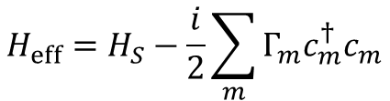
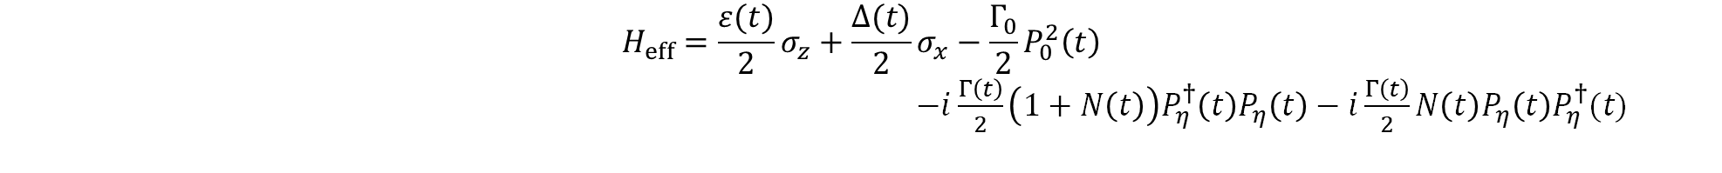
Quantum trajectories method
$$\frac{∂ρ_{S}(t)}{∂t}=−i\left[H\left(t\right),ρ_{S}\left(t\right)\right]−\frac{1}{2}\sum_{m}{Γ_{m}\left(c_{m}^{†}c_{m}ρ_{S}\left(t\right)+ρ_{S}\left(t\right)c_{m}^{†}c_{m}−2c_{m}ρ_{S}(t)c_{m}^{†}\right)}$$
Lindblad form:
$$H_{eff}=H_{S}−\frac{i}{2}\sum_{m}{Γ_{m}c_{m}^{†}c_{m}}$$
Effective Hamiltonian:
$$H_{eff}=\frac{ε(t)}{2}σ_{z}+\frac{Δ(t)}{2}σ_{x}−\frac{Γ_{0}}{2}P_{0}^{2}\left(t\right)$$
$−i\frac{Γ\left(t\right)}{2}\left(1+N\left(t\right)\right)P_{η}^{†}\left(t\right)P_{η}\left(t\right)−i\frac{Γ\left(t\right)}{2}N\left(t\right)P_{η}\left(t\right)P_{η}^{†}(t)$
Spin-boson
Effective Hamiltonian:

Slide 6
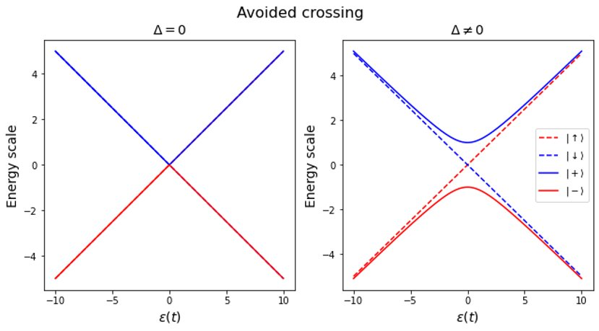



Quantum adiabatic theorem
$$H_{S}=\frac{ε(t)}{2}σ_{z}=\frac{ε(t)}{2}\left(\left.\left|↑\right.\right\rangle \left\langle ↑\right.|−\left.\left|↓\right.\right\rangle \left\langle ↓\right.|\right)$$
$$H_{S}=\frac{ε(t)}{2}σ_{z}+\frac{Δ}{2}σ_{x}$$
$$\frac{η_{±}(t)}{2}=±\frac{1}{2}\sqrt{ε^{2}\left(t\right)+Δ^{2}}$$
Figure 2: Two plots showing the eigen-energies of different states increasing with the detuning, ɛ(t). Solid lines represent the adiabatic states, and dashed lines the diabatic. The left-hand plot shows the case where Δ = 0 and the right plot where Δ ≠0.

Slide 7
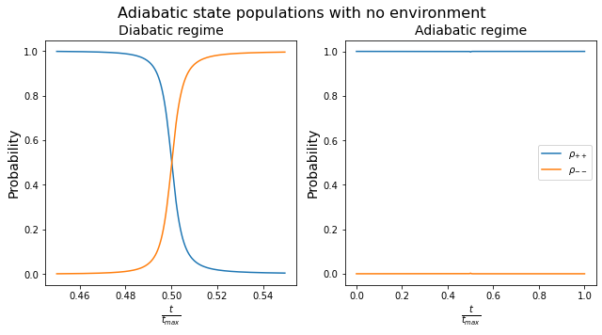
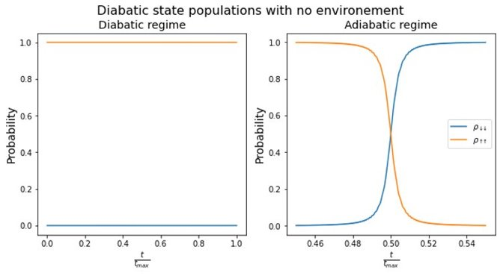
Quantum adiabatic Theorem - No environment
Figure 3: Two plots showing the populations of adiabatic states as we ramp the detuning, ɛ(t), diabatically (left) and adiabatically (right).
Figure 4: Two plots showing the populations of diabatic states as we ramp the detuning, ɛ(t), diabatically (left) and adiabatically (right).

Slide 8
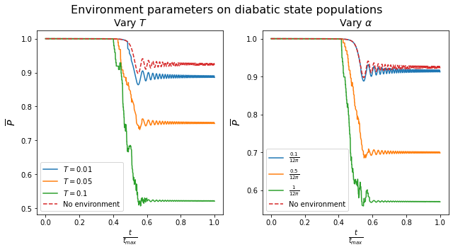
Quantum adiabatic theorem – Environment
Figure 5: Two plots showing the population of|↑〉with time when an environment is present. The left-hand plot shows the effects of varying the temperature, T, where we set α=1/12π and the right-hand plot shows the effects of varying the coupling strength, α, where we set T=0.1K.

Slide 9
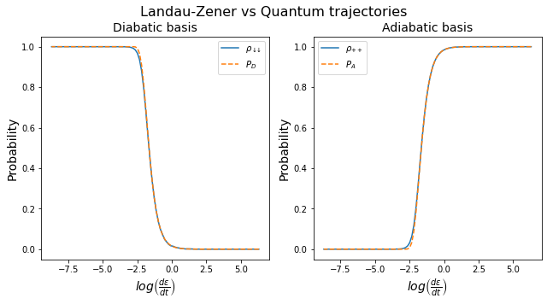



The Landau-Zener formula
Diabatic transition:
$$P_{D}=1−e^{−2πΓ}$$
$$P_{A}=e^{−2πΓ}$$
Adiabatic transition:
Gamma:
$$Γ= \frac{Δ^{2}}{\left|\frac{dε(t)}{dt}\right|}$$
Figure 6: Two plots showing the probability for transition as given by the Landau-Zener formulas compared against the quantum trajectories result.

Slide 10
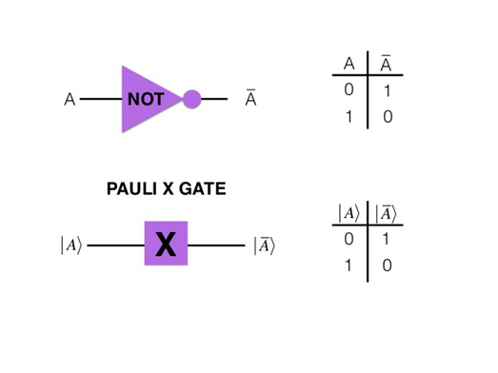
Thermodynamic applications – quantum logic gates
Figure 7: An image showing the effects of a classical NOT gate and its quantum counterpart, the X-gate, flipping the initial state [https://towardsdatascience.com/demystifying-quantum-gates-one-qubit-at-a-time-54404ed80640].

Slide 11



Heat and work
$$H_{S}= \frac{η(t)}{2}\left(\left.\left|+\right.\right\rangle \left\langle +\right.|−\left.\left|−\right.\right\rangle \left\langle −\right.|\right)$$
No environment
Environment
$$W_{A}=\left\langle ± | H_{S}(t_{max}) | ±\right\rangle −\left\langle ± | H_{S}(t_{0}) | ±\right\rangle$$
$$E_{jump}=\left\langle ± | H_{S}(t+δt) | ±\right\rangle −\left\langle ∓ | H_{S}(t) | ∓\right\rangle$$
$$=0$$
$$W_{jump}=\left\langle ± | H_{S}(t+δt) | ±\right\rangle −\left\langle ± | H_{S}(t) | ±\right\rangle ≠0$$
$$H_{jump}=\left\langle ± | H_{S}(t) | ±\right\rangle −\left\langle ∓ | H_{S}\left(t\right) | ∓\right\rangle ≠0$$
$$W_{D}=\left\langle ± | H_{S}(t_{max}) | ±\right\rangle −\left\langle ∓ | H_{S}(t_{0}) | ∓\right\rangle$$
$$≠0$$
$$H_{no jump}=\left\langle ± | H_{S}(t) | ±\right\rangle −\left\langle ± | H_{S}\left(t\right) | ±\right\rangle =0$$
$$W_{no jump}=\left\langle ± | H_{S}(t+δt) | ±\right\rangle −\left\langle ± | H_{S}\left(t\right) | ±\right\rangle =E_{no jump}$$

Slide 12
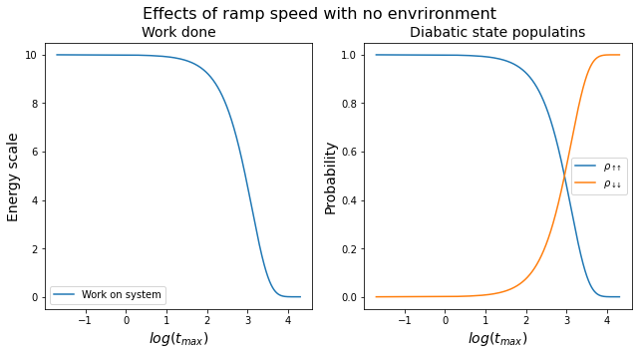
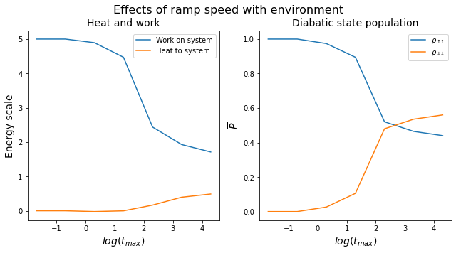
Heat and Work
Figure 8: Two plots showing the effects of ramp speed when no environment is present.
Figure 9: Two plots showing the effects of ramp speed in the presence of an environment with T = 0.1K.

Slide 13
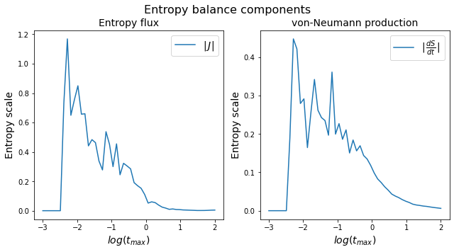
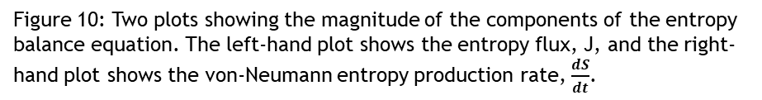



Entropy Balance
Entropy balance equation
$$σ\left(t\right)=\frac{dS(t)}{dt}+J(t)$$
Von Neumann Entropy
$$S\left(t\right)=−k_{B}Tr\left[ρ\left(t\right)ln(ρ(t))\right]$$
Entropy production rate
J$\left(t\right)=\frac{ω(t)}{T}\frac{d}{dt}E\left[N^{−}\left(t\right)−N^{+}(t)\right]$
Figure 10: Two plots showing the magnitude of the components of the entropy balance equation. The left-hand plot shows the entropy flux, J, and the right-hand plot shows the von-Neumann entropy production rate, $\frac{dS}{dt}$.

Slide 14
Future considerations
More complex quantum gates?
Generalize to higher dimensions?
Multi-leveled systems?
Heat engines?
Thank you

Slide 15
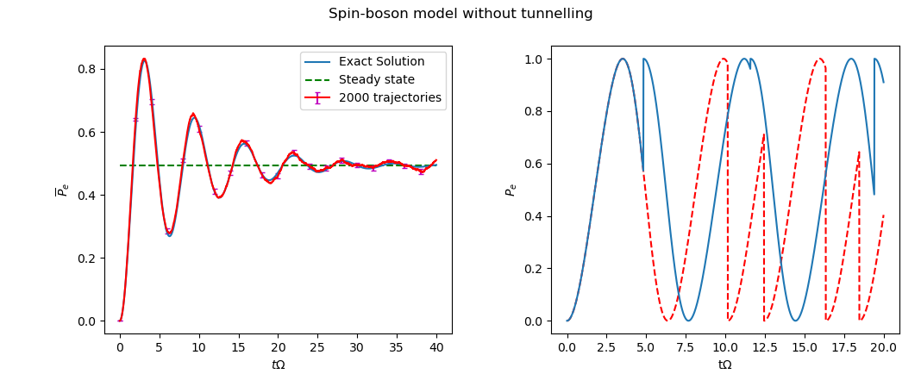
Diabatic basis
Figure 11: Illustrative example of quantum trajectories for the spin-boson model in the diabatic basis. Right: probability to find the atom in the excited state, for two random sample trajectories starting in the ground state. Left: population of the excited state averaged over 2000 trajectories (red line), compared with the exact solution found from direct integration of the master equation (blue line).
15

Slide 16
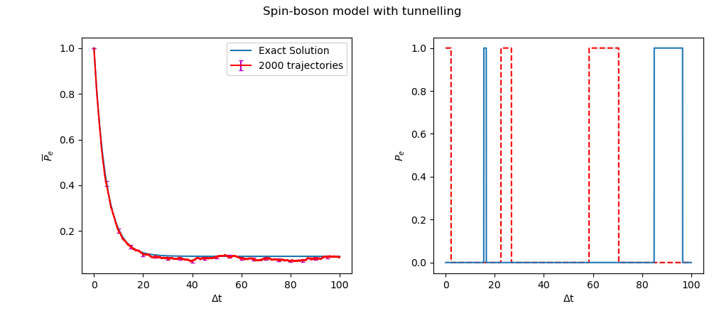
Adiabatic basis
Figure 12: Illustrative example of quantum trajectories for the spin-boson model with tunnelling, working in the energy eigenbasis. Right: population of the excited state for two random sample trajectories propagating in time, one starting in the ground state (solid blue line) and one in the excited state (dashed red line). Left: population of the excited state averaged over 2000 trajectories compared with the exact solution calculated from direct integration of the master equation.
16

Slide 17
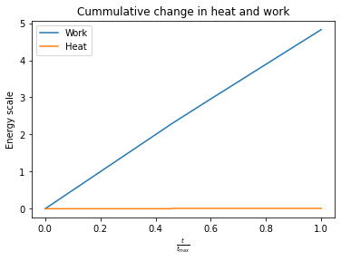
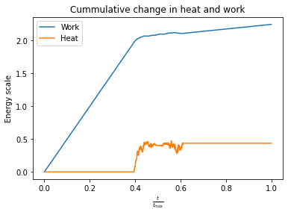
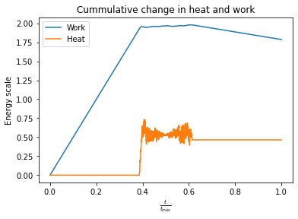
Figure 13: Graphs showing the cumulative heat and work in 3 different regimes: top left is the diabatic regime with tmax = 20, top right is a middling regime with tmax = 200, bottom right is the adiabatic regime with tmax = 20,000.
17

Slide 18
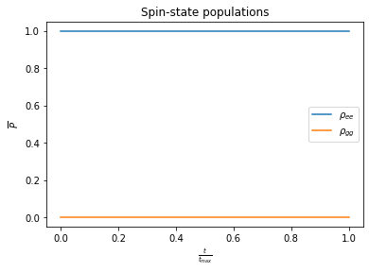
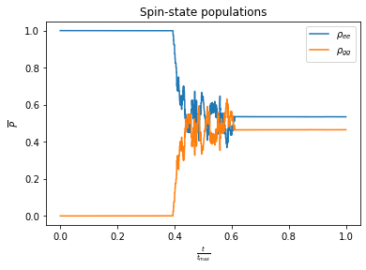
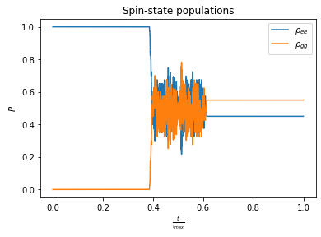
Figure 14: Graphs showing the spin-state populations in 3 different regimes: top left is the diabatic regime with tmax = 20, top right is a middling regime with tmax = 200, bottom right is the adiabatic regime with tmax = 20,000.
18

